Slide 1

Financial Performance Analysis using Tableau
Unleash the power of data visualization to gain actionable insights into your financial performance. This presentation will explore the transformative capabilities of Tableau for analyzing, visualizing, and forecasting your financial health.

Slide 2
Introduction to Tableau and its Capabilities
Intuitive Interface
Data Connectivity
Interactive Dashboards
Tableau offers a user-friendly interface that empowers users with limited technical skills to create impactful visualizations.
Connect to a wide range of data sources including spreadsheets, databases, cloud platforms, and even live data feeds.
Create interactive dashboards that allow users to explore data, drill down into details, and gain insights at a glance.

Slide 3

Data Sources and Data Preparation
Data Acquisition
Data Cleaning
Identify and access relevant financial data from various sources like accounting systems, CRM, and external databases.
Clean and transform raw data to ensure accuracy, consistency, and completeness, removing duplicates and inconsistencies.
Data Integration
Combine data from multiple sources to create a unified dataset for comprehensive analysis and visualization.

Slide 4
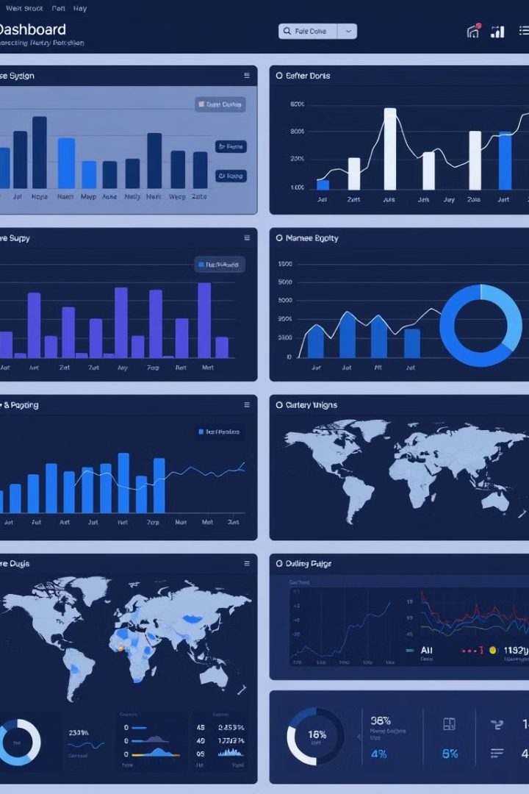
Creating Interactive Dashboards
Drag-and-Drop Functionality
Interactive Filters
Enable users to filter data and explore different segments of the data, gaining personalized insights.
Build dashboards with ease using a drag-and-drop interface, arranging visualizations and customizing layouts.
Customizable Visualizations
Select from a wide variety of charts and graphs, customize their appearance, and tailor them to specific business needs.

Slide 5
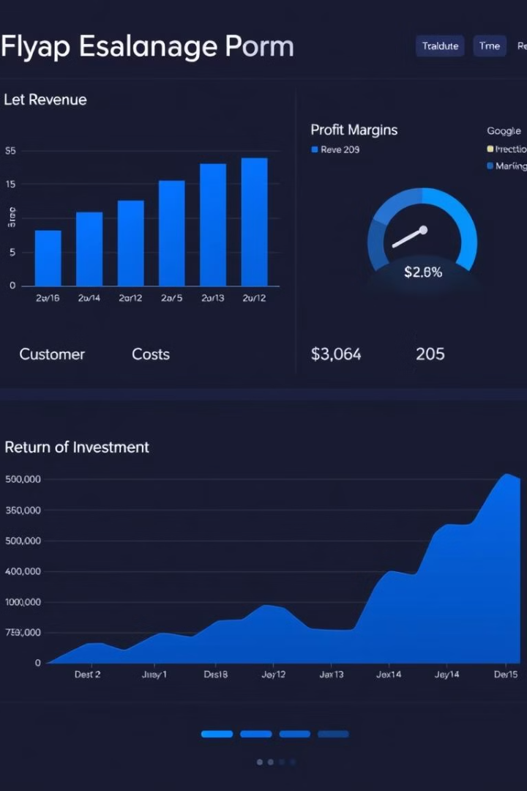



Visualizing Key Performance Indicators
Revenue Growth
Track the growth of revenue over time, identify trends, and pinpoint areas for improvement.
Profitability
Analyze profit margins and identify opportunities to optimize profitability by reducing costs or increasing sales.
Customer Acquisition Cost
Monitor customer acquisition costs, identify effective marketing channels, and optimize spending for growth.

Slide 6
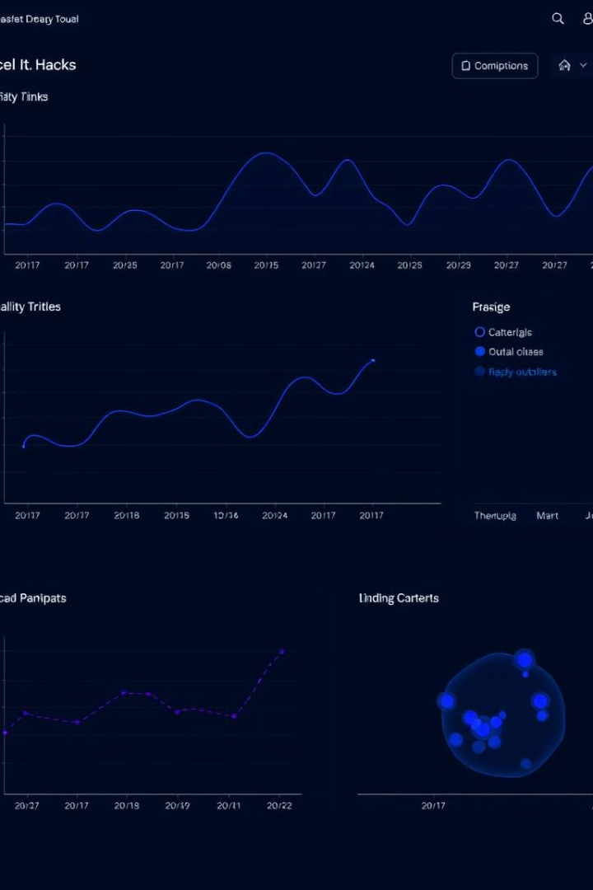
Analyzing Financial Trends and Patterns
1
Trend Analysis
Use line charts and trend lines to identify trends, seasonality, and cyclical patterns in financial data.
2
Correlation Analysis
Explore relationships between different financial metrics using scatter plots and correlation coefficients.
3
Outlier Detection
Identify unusual data points, investigate potential causes, and adjust analysis accordingly.

Slide 7
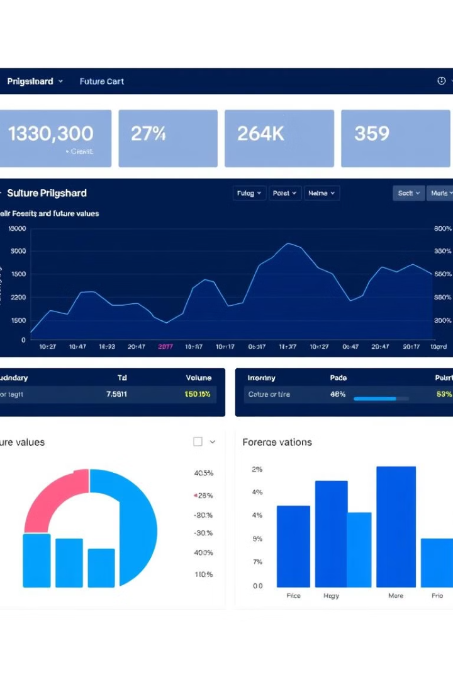



Forecasting and Predictive Analytics
Time Series Forecasting
Use historical data to predict future financial performance, identify growth opportunities, and plan for future needs.
Regression Analysis
Analyze the relationship between independent and dependent variables to predict future outcomes and understand cause-and-effect relationships.
Scenario Planning
Create multiple scenarios to explore different possibilities and assess the impact of potential changes on financial performance.

Slide 8
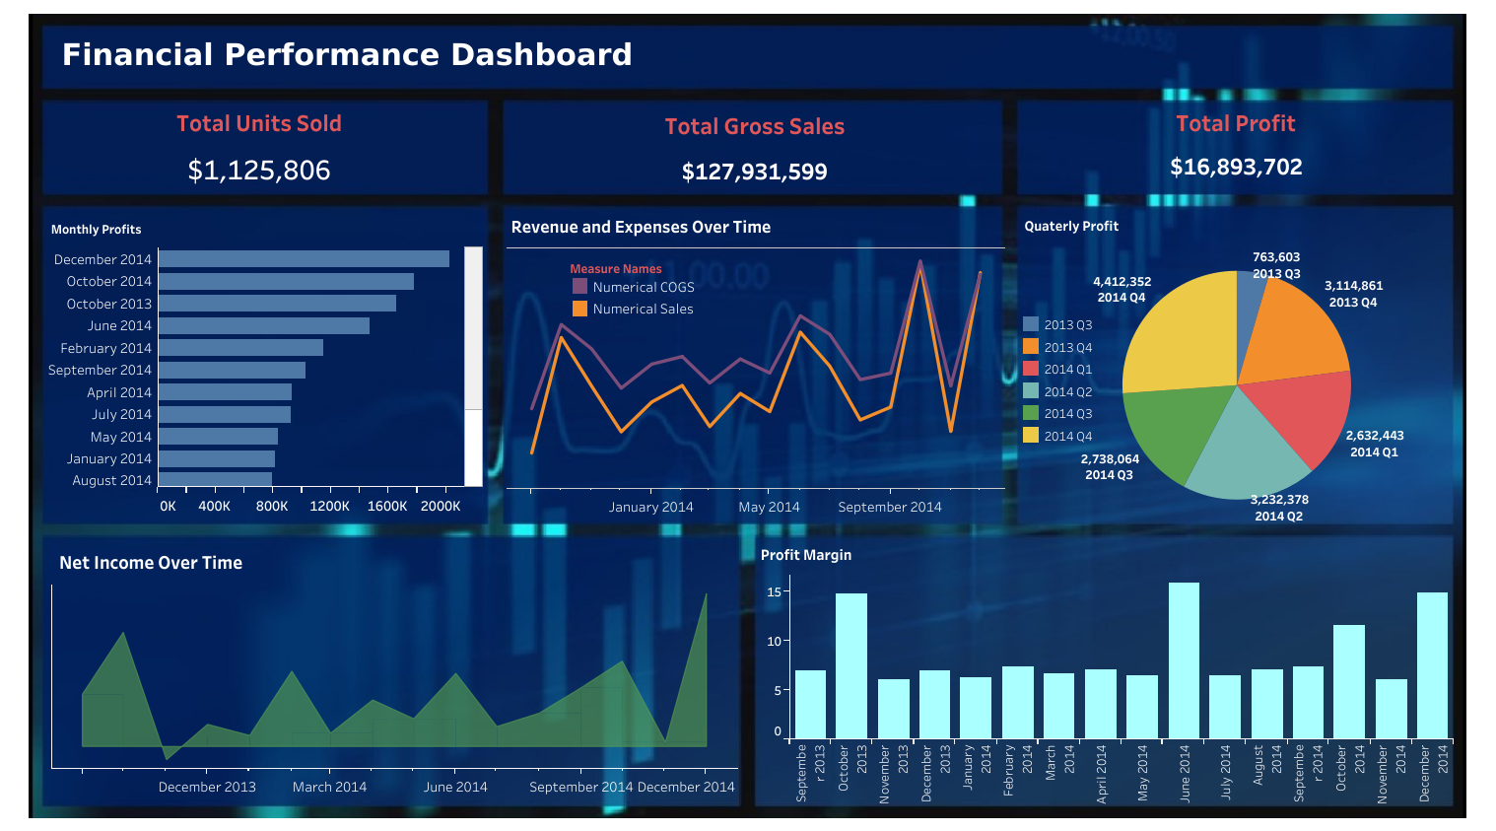

Slide 9

Conclusion and Key Takeaways
Harnessing the power of Tableau empowers you to make data-driven decisions, optimize financial performance, and drive your business forward. Explore the full potential of Tableau for transforming your financial analysis and insights.

